Slide 1
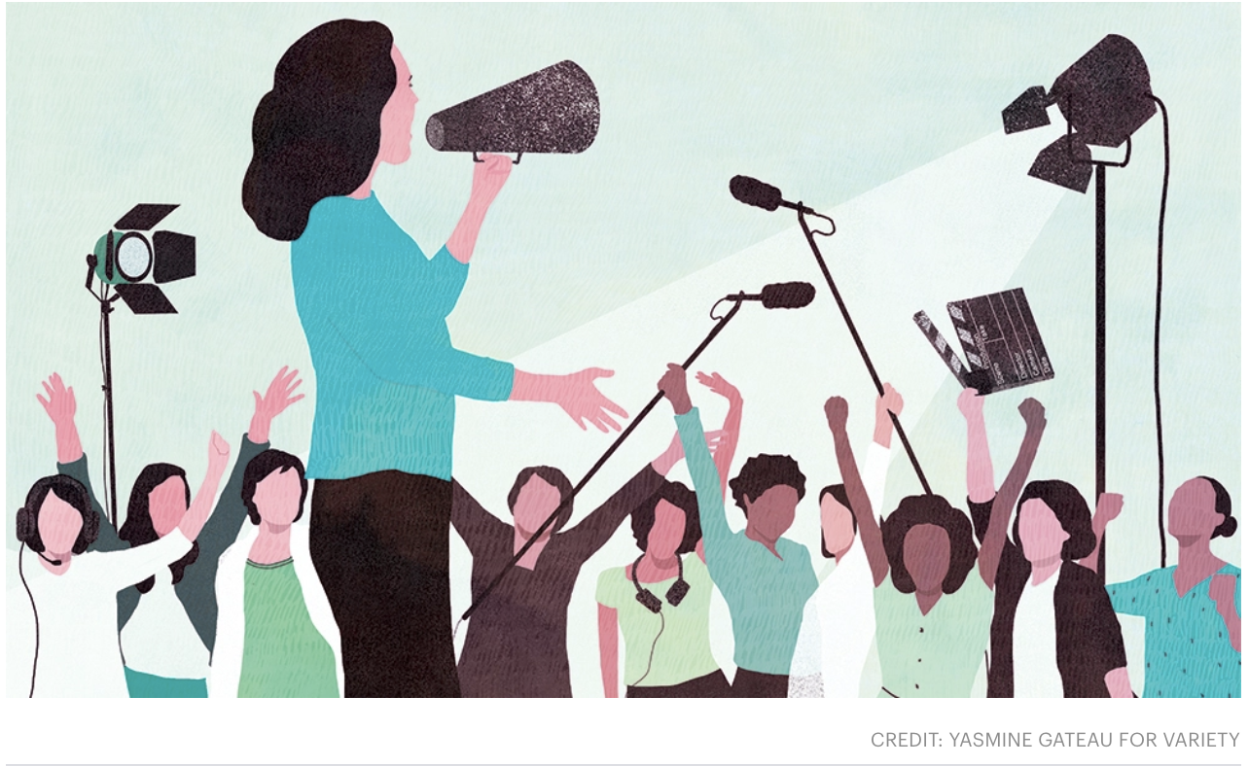
The Women Who Produce the Media
A Podcast Series
By Maxine Gross

Slide 2
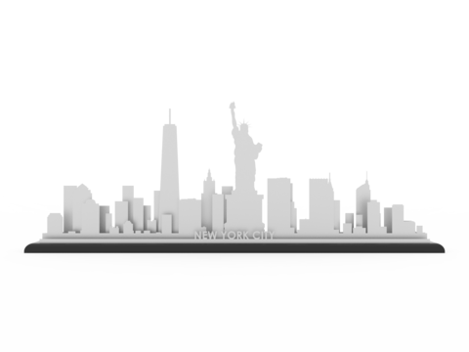
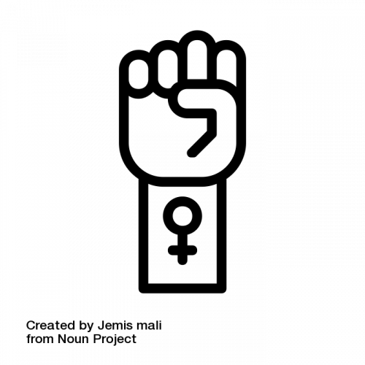
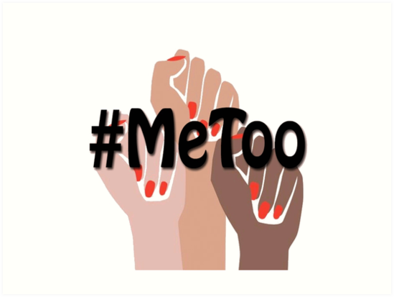
Identity
Digital Media Production
Upbringing
Working in Film or Filmmaking
Women’s Issues
#MeToo
Sound and Audio

Slide 3
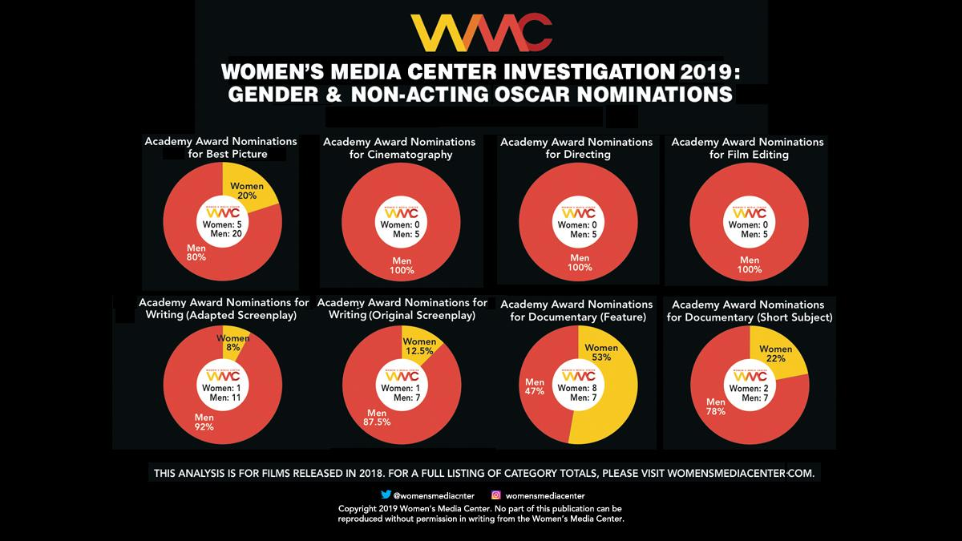
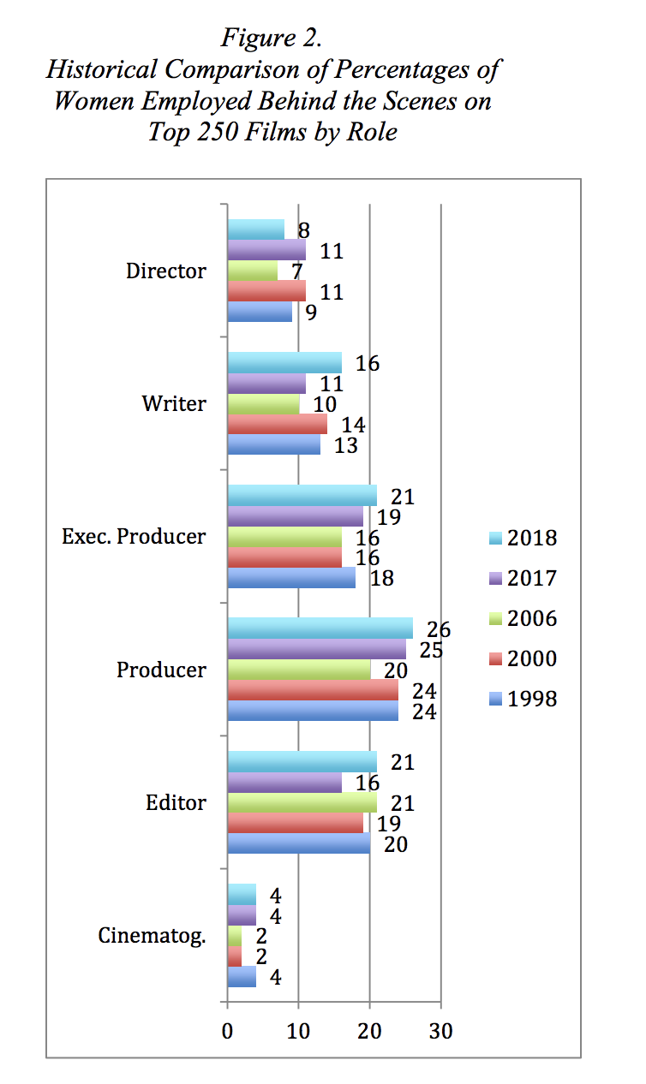
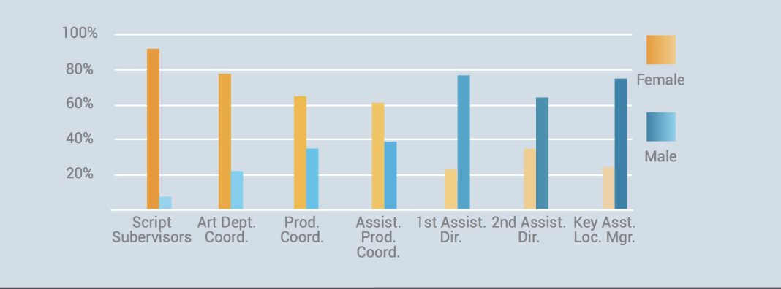
Why Women Who Produce?
Yellow = Female Nominations
Via The Celluloid Ceiling
Via the Celluloid Ceiling
Notes:
Future Aspirations
Job description
Emphasis on Communication
The Personal Is Political

Slide 4
Producers Interviewed
Producers Interviewed
Kati Johnston is an Executive Producer on the CBS TV Show Bull. Her credits include Law and Order and The Naked Brothers Band.
Willa Goldfeder is a Commercial Line Producer who has worked on ads for companies including Nike, Google, and the MLB.
Celia Costas is an Emmy award winning Executive Producer for her work on the HBO’s Angel’s in America. Some of her credits include A Quiet Place and Zoolander.

Slide 5
Producers Interviewed
Deb Dyer is a Producer and Production Accountant. She is partners with Celia Costas.
Molly Allen is an Executive Producer working in Hollywood on films. Her credits include Fences and Iron Man.
Kelsi Russell is a Production Supervisor and Coordinator who currently works in TV. Her credits include TV shows like 30 Rock and Orange is the New Black.

Slide 6
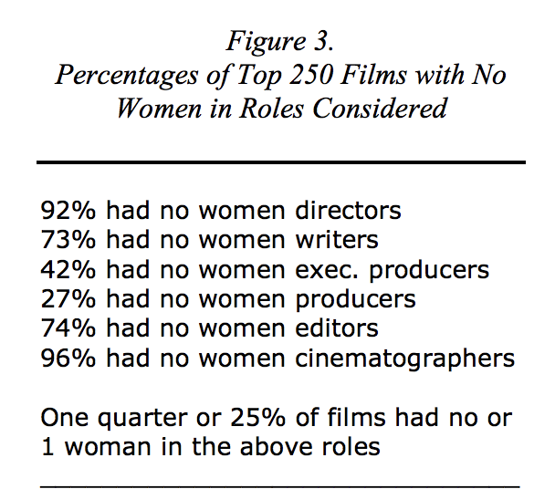
Competition Among Women in the Industry
“I often feel more pressure and intensity from the women I’m in meetings with. Because the scrutiny is on them: If you are favoring a woman, are you doing that just because you are a woman or not? So I think that’s actually the biggest thing that needs to be fixed in Hollywood. Not having women be afraid of other women would be a very nice thing to happen.”
Leigh Janiak, writer, director, “Honeymoon”
The Reality in New York City TV and Film
Community and its role.
Changing Culture as a result of the #MeToo movement
Via the Celluloid Ceiling

Slide 7
Motherhood vs. The Media Industry
“My husband is shooting a movie, and our son is 3, and everyone around him is not going, ‘Oh, my god, what are you going to do with your son?’ We give fathers all kinds of permission to focus on their work, to be creatively consumed, but mothers with that same determination make everyone uneasy. The guilt is unreal.”
Miranda July, writer, director, actress, “Me and You and Everyone We Know,” “The Future”
“I don’t have a personal life”
Judgement by Co-workers
The idea of being absent
Social construct of what “Motherhood” should look like.

Slide 8
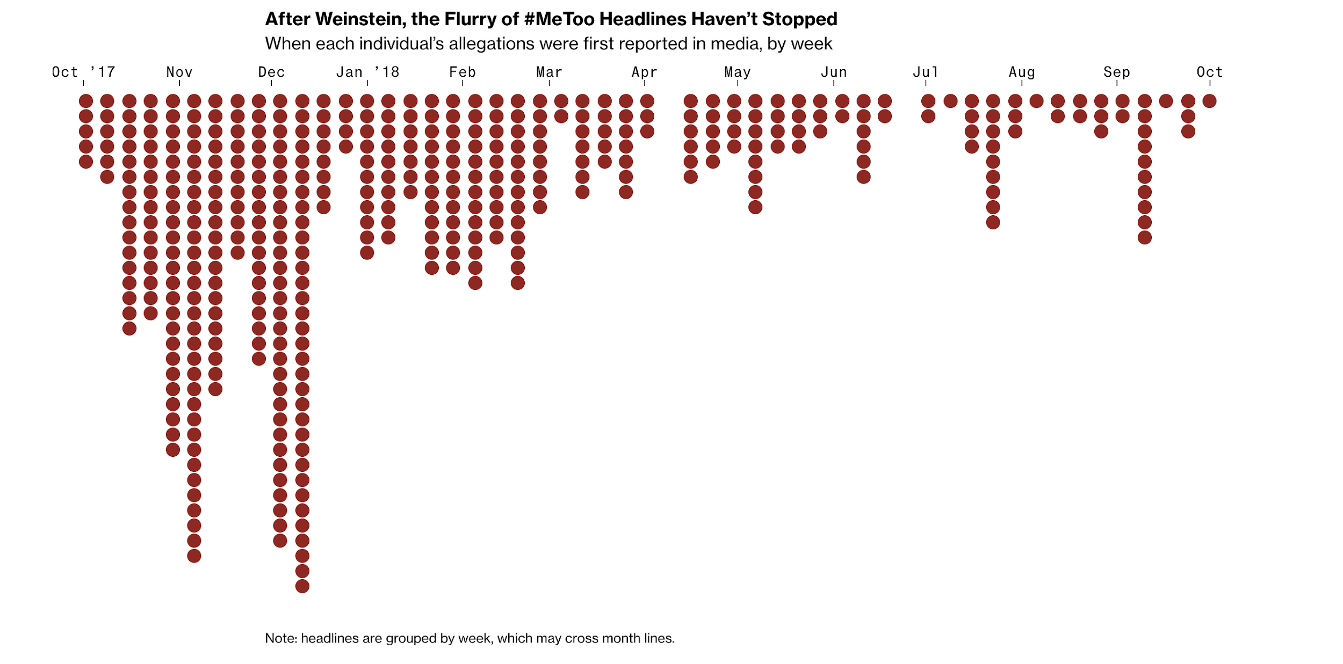
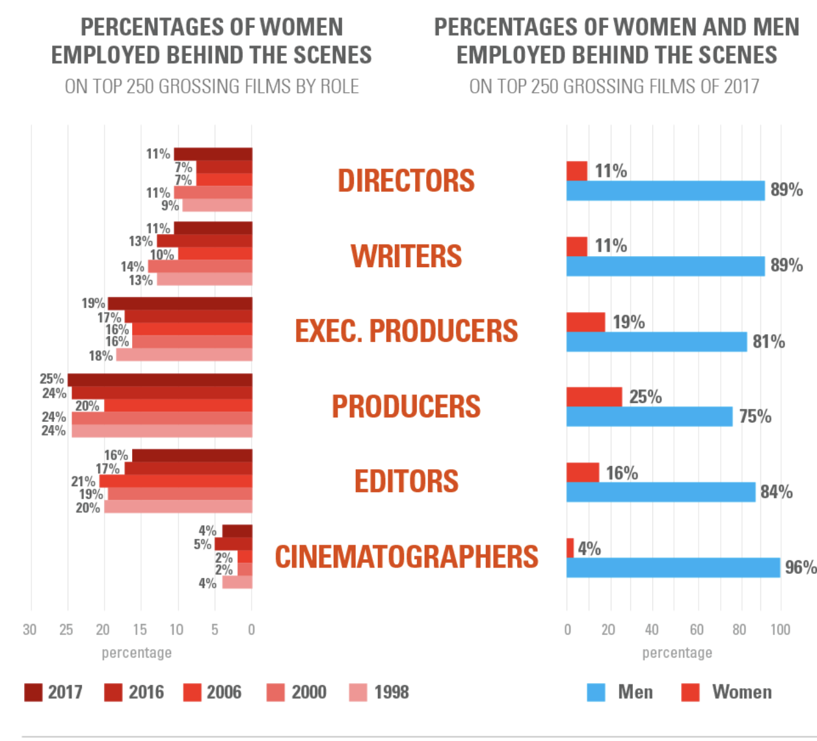
The Impact of the #MeToo Movement
The Beginning of change
Oped up channels of communication
“A huge win”
Change in on-set culture
Title IX training taken more seriously
#MeToo movement does focus on women working in front of the camera, not those behind
Put a spotlight on the film industry.
Call for Diversity

Slide 9
Why Are So Many Women Producing?
The job of a producer is typically rooted in multitasking and communication
An emphasis on nurturing
Traditional roles for women
Rooted in gender stereotypes
Unions are taking on more women

Slide 10
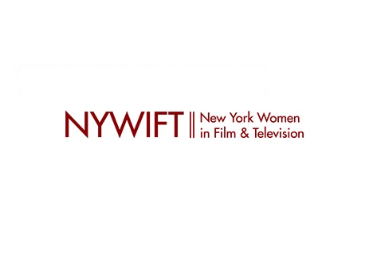
The Future of Women in Film
Need for Proper Training
The #MeToo Movement is the tip of the iceberg
Change doesn't happen overnight
The acknowledged need for diversity
Race/Gender/Sexuality
Women as the Heads of Studios
Eliminate the culture of competition
More support for Organizations that sponsor mentoring
WITF and PGA

Slide 11
Work Cited
The Impact of the #MeToo Movement
Dowd, Maureen. “The Women of Hollywood Speak Out.” The New York Times, The New York Times, 20 Nov. 2015, www.nytimes.com/2015/11/22/magazine/the-women-of-hollywood-speak-out.html?mcubz=3.
Griffin, Riley, et al. “#MeToo: One Year Later.” Bloomberg.com, Bloomberg,
www.bloomberg.com/graphics/2018-me-too-anniversary/.
Hanisch, Carol. “The Personal Is Political .” The Personal Is Political: the Original Feminist Theory Paper at the Author's Web Site, www.carolhanisch.org/CHwritings/PIP.html.
Lauzen, Martha M. “The Celluloid Ceiling: Behind-the-Scenes Employment of Women on the Top 100,250, and 500Films of 2018.” Women In TV and Film , womenintvfilm.sdsu.edu/wp-content/uploads/2019/01/2018_Celluloid_Ceiling_Report.pdf.
Lauzen, Martha. “Academy's Failure to Nominate Women Directors Reinforces the Status Quo (Guest Column).” Variety, 24 Jan. 2019, variety.com/2019/film/opinion/oscar-nominations-women-directors-status-quo-1203116121/.
Perrone, Jeanne Joe. “Gender Inequality in Film Infographic for 2018.” New York Film Academy Blog, 8 Mar. 2018, www.nyfa.edu/film-school-blog/gender-inequality-in-film-infographic-updated-in-2018/.
“Script Girls, Secretaries and Stereotypes.” Working IDEAL, www.workingideal.com/reelequity/.
“Status of Women in the Industry.” New York Women in Film & Television, 5 Apr. 2019, www.nywift.org/status-of-women-in-the-industry/.

